Slide 1
Hooks, Props and State

Slide 2
Props
const Component = () =>
props
Returns jsx
<Component myprop="somevalue" />

Slide 3
Props
const Component = (props) =>
props
Returns jsx
<Component myprop="somevalue" />

Slide 4
Strict rule: Props are read-only

Slide 5


Slide 6


Slide 7


Slide 8
Passing arguments to components
Using HTML-like attribute syntax
Receiving component accesses props object Allow for better reusability of components
Props Takeaways

Slide 9


Slide 10
map
const numbers = ["one", "two", "four"];
const numbersPrefixed = numbers.map(n => "Number " + n);
// ["Number one", "Number two", "Number four"]

Slide 11
The key prop
Array:
{ address: "432 Tree Lane" }
{ address: "495 Newton St" }
Array:
{ address: "33 Palm Dr" }
{ address: "432 Tree Lane" }
{ address: "495 Newton St" }
33 Palm Dr
432 Tree Lane
432 Tree Lane
map
map
495 Newton St
495 Newton St

Slide 12
The key prop
Array:
{ address: "432 Tree Lane" }
{ address: "495 Newton St" }
Array:
{ address: "33 Palm Dr" }
{ address: "432 Tree Lane" }
{ address: "495 Newton St" }
33 Palm Dr
432 Tree Lane
432 Tree Lane
map
map
495 Newton St
495 Newton St

Slide 13
The key prop
Array:
{ id: 1, address: "432 Tree Lane" }
{ id: 2, address: "495 Newton St" }
1. 432 Tree Lane
map
2. 495 Newton St

Slide 14
Use id property if present
Choosing a Key Value
Else any combination of properties that is unique
Last resort: index provided by map function

Slide 15
A function
Starts with "use"
Encapsulates complexity
Access React's features Custom hooks Imported
Hooks

Slide 16
Only call hooks at the top level
They should always be called
In the same order
Only call hooks in function components
Or custom hooks
Rules of Hooks

Slide 17
Components and State
State
props
Returns jsx

Slide 18
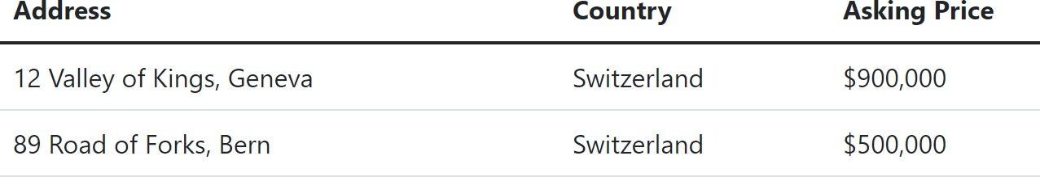
One Way Data Flow
[
{
id: 1,
address: "12 Valley of Kings, Geneva", country: "Switzerland",
price: 900000
},
{
id: 2,
address: "89 Road of Forks, Bern", country: "Switzerland",
price: 500000
},
]
{houses.map(h => (
<HouseRow key={h.id} house={h} />
))}

Slide 19
State is internal data managed by a component
Introduced by state hook
Parameter: initial value
Returns: array with current value and function to change it (the "set function")
Change the state using the set function only
State Main Takeaways

Slide 20
A prop value can change

Slide 21
React element
tr
React element
tr
React element
td
React element
td
React element
td
React element
td
React element
tr
React element
tr
React element
td
React element
td
React element
td
React element
td
React element
tr
React element
td
React element
td

Slide 22
React element
tr
React element
tr
React element
td
React element
td
React element
td
React element
td
React element
tr
React element
tr
React element
td
React element
td
React element
td
React element
td
React element
tr
React element
td
React element
td

Slide 23



Core React Features
Structure with components Reusability
Have state
UIs declared in JavaScript Rendered output changes when state is updated
Efficiency with reconciliation Only updates the parts
of the UI that changed

Slide 24
Next up:
Component Rendering and Side Effects

